Slide 1
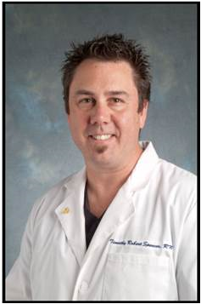
GOVAN
A Network of the Association for Vascular Access
Network Meeting & Education Event “Use of Midline Catheters: Strategy or Risk”
Sponsor:
Speaker: Timothy R. Spencer, RN, DipAppSci, BHealth, ICU Cert, APN, VA-BC™ Vascular Access Consultant™
Recognize the appropriate clinical use of midline catheters
Review current practice and evidence regarding midline use
Review policy structure to ensure inclusion of critical elements
Identify appropriate strategies and use of technology to optimize midline catheter outcomes
Where: Brio Tuscan Grille
1500 Polaris Pkwy
Columbus, OH 43240
When: Wednesday, October 18, 2017
Agenda: Registration - 5:45pm – 6:15pm
Dinner/Lecture/Round Table
RSVP required: govan8.wildapricot.org
RSVP deadline: Friday, October 13, 2017
Event Fee: Members – Free
Non-Members: $20
***Event is limited to 45 attendees***
Format: Lecture and round table; please bring a copy of your midline-related policies.
This lecture and round table activity will enhance your Midline knowledge, review policy inclusions related to midline use and ensure alignment of policy and practice for Midline use in your facility.
Approved for 1.0 CE for RN and RRT

