Slide 1
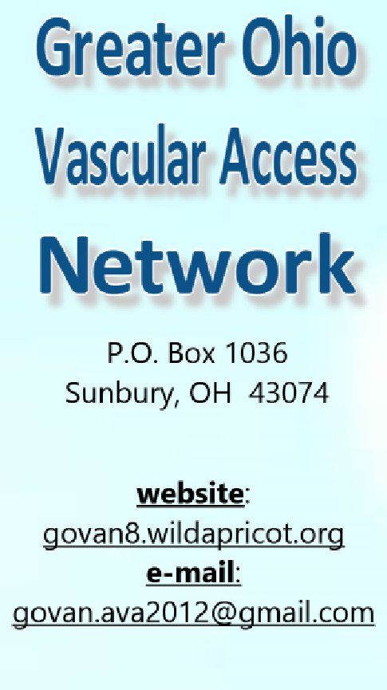
Join us for an exciting evening talking about what we love…VASCULAR ACCESS!!
When: October 5, 2016 5:45PM – 8:00PM
Where: The James Cancer Hospital
460 W 10th Ave
Columbus Ohio 43210
Room L035-Conference (by Au Bon Pain)
Parking: South Cannon Garage
Free parking when pre-registered
Guest Speaker: TBA
Topic: Near Infra-Red Technology: What You May Not Know
Register: govan8.wildapricot.org
Members are free
Nonmember joining GOVAN $30
Nonmember event only $15
Submitted for 1.0 Contact Hour
Guest Speaker and dinner provided by Christie Digital®

